Slide 1
RDM in Court: Creating a repository for the Robinson Treaties Annuities Case
Tomasz Mrozewski
Laurentian University

Slide 2
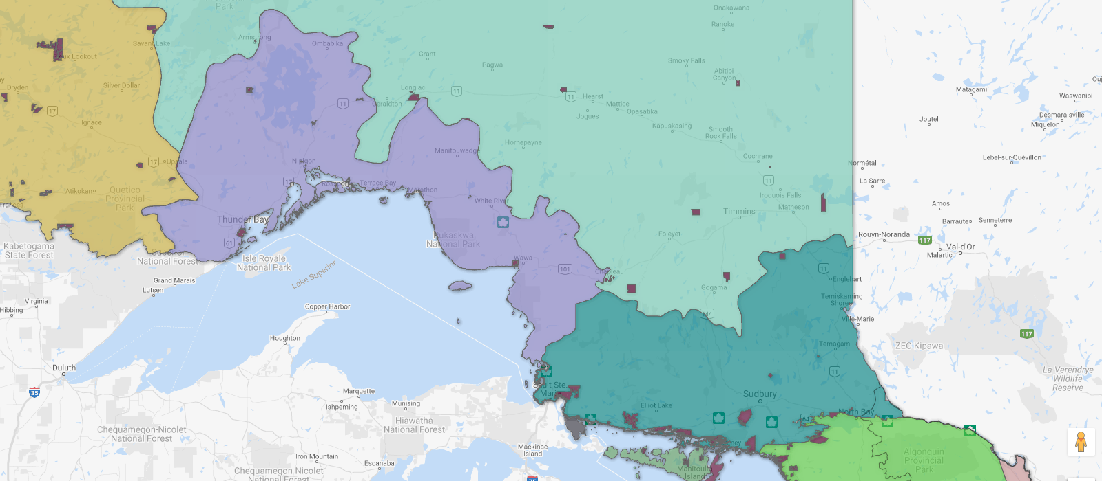
Robinson Huron and Robinson Superior Treaties
Robinson Huron Treaty
(September 9, 1850)
Robinson Superior Treaty
(September 7, 1850)
Source: Ontario Ministry of Indigenous Affairs, Map of Ontario Treaties and Reserves

Slide 3
The claim
"[I]n this case the plaintiffs seek a declaration that since 1850 the Crown has and remains legally obligated, under the Robinson Huron Treaties of 1850, to increase the annuities from time-to-time if the territory produces an amount which would enable it to do so without incurring loss, and the size of the annuity is not limited to an amount based on 1 pound per person, or otherwise expressed 4 dollars per person.“
The Honourable Justice Patricia C. Hennessy, September 25, 2017

Slide 4
The project
To create a open, digital repository of testimony, exhibits, statements and other materials submitted to and created by the Court in the case.
26 expert witness reports, reply reports, and affidavits
11,884 pages of transcripts (Phase I only)
224.8 GB of video (Phase I only)
Opening and closing statements; chronologies; exhibit lists; etc.
Indices of approx. 2,500 primary and secondary historical documents referenced (plus digital images?)

Slide 5
Technical solution
Collection subject to a Court order (currently being drafted); follows the Court’s Decision on Broadcasting (2018 ONSC 114, http://canlii.ca/t/hpx5c)
Use Scholars Portal Dataverse and (probably) OLRC to host the document collection
Create documentation and pathfinders to help navigate collection and contextualize items in civil proceedings
Working with two advisory groups: one legal (reps from all parties), one Indigenous

Slide 6
Being an “accomplice”
Working closely with Office of the Associate Vice President, Academic & Indigenous Programs (AVPAI)
Working with Laurentian University Native Education Council (LUNEC) to form an advisory group of Indigenous faculty and community members from Treaty territories and across Ontario
Ensuring that the work is done “in a good way”

